Slide 1
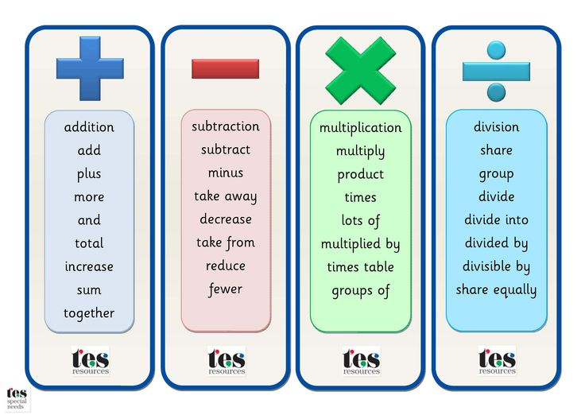
Times Tables:
Knowing times tables facts is crucially important to your child’s progression in their mathematics education. Without a thorough understanding of multiplication and division facts, children frequently get ‘lost’ when it comes to do anything with fractions and any multiplication or division with larger numbers. Many mental maths activities require a quick recall of multiplication and division facts. By the end of Year 3 children are expected to recall their 2, 3, 4, 5, 8, 10 including the division facts.
The key to learning times tables is frequent repetition and regular revision. Five to ten minutes every day is better than an hour a week. Here are some ideas to help your child memorise their multiplication and division facts.
Chanting- When beginning to learn a times table this is key. Repeatedly reading a times table out aloud will help your child become familiar with the multiples for
that times table.
Flash Cards- Make a set of cards for the times table being learnt by putting a question on one side of the card (6 x 5 =) and the answer on the reverse (30). Go through the cards reading the question and then turning over to see the answer.
Learning Times Tables - A multiplication square is particularly useful for establishing the link between multiplication and division facts but can also be used instead of a times table
list. When children are more confident with their times table knowledge, a blank multiplication square can be filled in. Time your child to complete their square, or see how many multiples they can complete in a set time. Can they
beat their score and time?
Games - To help your child with this learning we have access to Times Tables Rock Stars. Every child in Year 3 has a log in to access their own profiles.
Vocabulary
Maths at Home
For parents with children in Year 3
Where can I find more information:
There are lots of useful websites on the internet. Here are some websites you may find useful which include a range of engaging games linked to the curriculum.
Useful maths websites:
www.oxfordowl.co.uk/maths-owl/maths
www.maths4mumsanddads.co.uk
www.nrich.maths.org
www.amathsdictionaryforkids.com
www.theschoolrun.com/maths-parents
www.bbc.co.uk/bitesize/ks1/maths
www.mathsisfun.com
www.topmarks.co.uk
www.ictgames.com
www.counton.org
https://www.topmarks.co.uk/maths-games/hit-the-button
http://www.familylearning.org.uk/online_math_games.html
Children’s Maths skills can be greatly boosted by help at home, in the same way that regular help with spelling and reading can nurture their English skills.
At Oakworth Primary School, we aim to teach children to work with number in lots of different ways. We know that what works for one child will not always make sense to another and that by giving them a range of different methods, they will be well equipped to select one which works for them. So please, be encouraged to talk about maths with your child, you never know, they may even teach you a new thing or two!
If you have any questions please speak to your child’s class teacher.
We would like to thank you for your continued support.

Slide 2
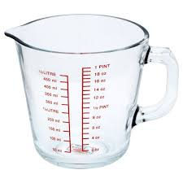
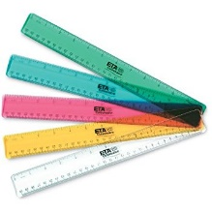
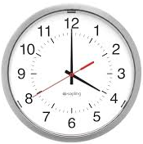
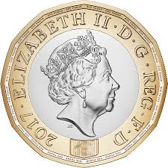
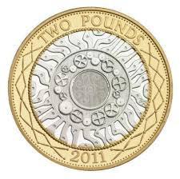
Activities you can complete at home:
Activities you can complete at home:
Activities you can complete at home:
Shape: You could take your child on a ‘shape walk’ around an area such as Cliff Castle to see what shapes they can spot. Look at the buildings or playground equipment to spot right angles and symmetrical shapes. Can they identify any irregular shapes by counting the numbers of sides?
Telling the time: Make sure that there are both analogue clocks and digital clocks around the house for your child to practise reading the time to 5 minute intervals. Ask them to be ‘human alarm clocks’ and to let you know when the oven needs turning off at 20past 6. A watch is a great birthday present at this age if they haven’t got one. Encourage your child to solve problems involving time e.g. this programme starts at 12:20 and it is 50minutes long. What time will it finish?
Measuring Length:
You will need a ruler in centimetres and millimetres.
Use the ruler to draw 10 different straight lines on a piece of paper.
Measuring Volume:
You need a 1 litre measuring jug and a selection of different mugs, cups or beakers. Ask your child to fill a mug with water. Pour the water carefully into the jug. Read the measurement to the nearest 10ml. Write the measurement on a piece of paper. Do this for each mug or cup. Now ask your child to put them all in order.
Money:
While shopping, point out an item costing less than £1. Ask your child to work out in their head the cost of three items. Ask them to guess first. See how close they came. If you see any items labelled, for example, ‘2 for £3.50’ ask them to work out the cost of one item. Ask them to explain how they got their answer.
Ask your child to estimate the length of each line and write this on the line in centimetres and then in millimetres. You should then complete this activity yourself and write it in a different colour.
Now give them a ruler and ask them to measure each line to the nearest millimetre.
Ask them to write the measurement next to the measurement and then find the difference.
A difference of 5 millimetres or less scores 10 points. A different of 10 centimetre or less scores 5 points.

